Slide 1
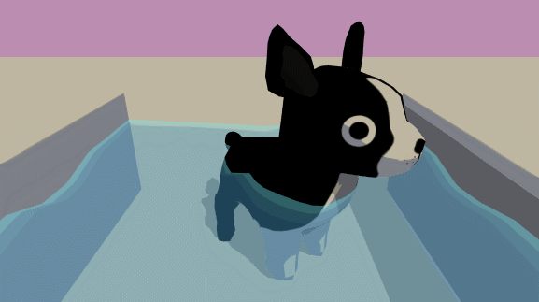
Unity Shaders
& Post Processing Effects
CS23 Class 10/4
Hannah Shaby
Water Shader by Linden Reid

Slide 2
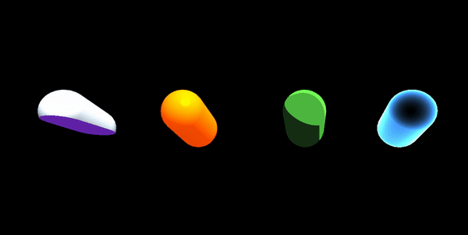

Slide 3
What are Shaders?
Shaders take object data (color, coordinates, textures) and modify the appearance of that object
Can be used in both Unity 2D and 3D
Unity shaders written in HLSL or made with Shader Graphs
Shader
Object Data
Rendered image
Notes:
Talk about HLSL and Shader graphs → shader graphs exist in unity and can be manipulated by the user without having to code in HLSL!!
Popular approach to writing shaders in HLSL in CS23 is to edit code of existing shaders. Uses syntax similar to C.

Slide 4
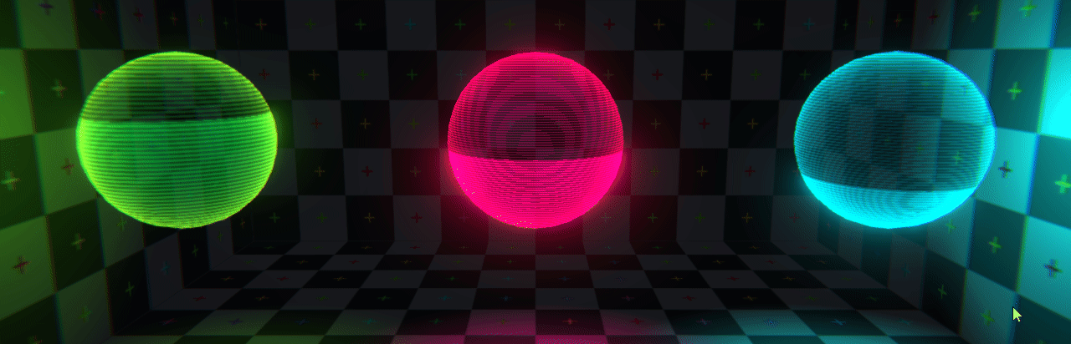
Why are Shaders Useful?
Emulate materials
Aesthetics
Special effects
Hologram Shader by Andy Duboc
Notes:
Materials → make otherwise smooth objects have texture, make them shiny or rough, add additional detail without making a 3D object have too many vertices and get complicated
Aesthetics→ add visual effects or style to improve game feel
ex: a toon shader to give 3D objects a flat look
Special effects→ hologram example on the slide, things like water, glowing objects can also be done with shaders. Fire shaders exist but particle effects (a type of animation) are often used

Slide 5
Types of Shaders
Shaders
2D Shaders
3D
Shaders
Fragment Shaders
Vertex Shaders
Geometry Shaders
Tessellation Shaders
Ray Tracing
Notes:
(also ray tracing and primitive shaders)
Main focus will be on Fragment and Vertex shaders since these are the shaders that Unity uses as well and have the simplest process to calculate shading

Slide 6
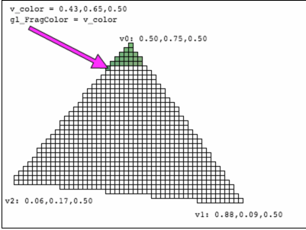
Fragment Shaders
Each pixel gets an equation that calculates its final appearance
Used in both 2D and 3D rendering
Each pixel is rendered independently!
Fragment Shader
Pixel
Final Pixel
Color
Texture
Position
New Color
Notes:
Talk about parallel processing

Slide 7
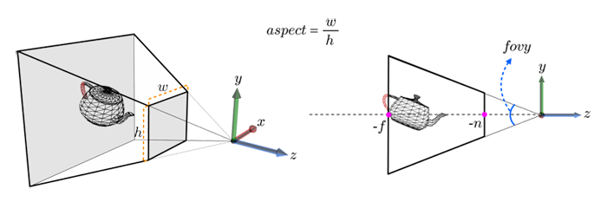
Vertex Shaders
Converts each 3D vertex’s position to 2D based on camera location
Manipulates basic attributes of each vertex (color, position, texture)
Notes:
Vertex shaders are typically used earlier in shading than fragment shaders

Slide 8
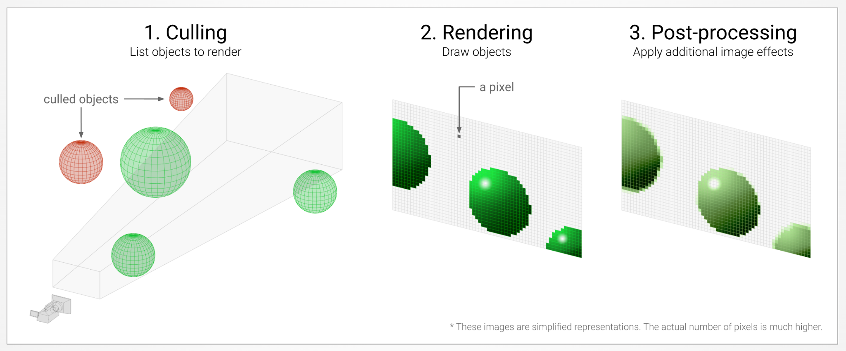
Unity Render Pipeline

Slide 9
Adding Shaders in Unity
Shaders are applied to materials.
There are 2 ways to get shaders in Unity
Unity has Legacy Shaders available as part of the platform
You can also upload Custom Shaders using .shader files
You can write your own
Find and alter open source shaders from others with credit
Notes:
This is just a preview of the demo

Slide 10
Demo of 3 Shaders
Go to class website>week 4b>Download “ShaderDemoMaterials” folder
Create a new scene: Unity 3D, upload ShaderDemoMaterials to assets folder
Working with 2 custom shaders and 1 Unity Legacy shader
Unity Shader: Reflective: Parallax Specular
Custom shaders by:
Toon: @roystan on github
Slice: @IppokratisBournellis on Unity Forum
Notes:
Demo:
Creating a material
Adding shader to a material in unity
(Both using custom and unity shaders)
Adding shader to object
Experimenting with shader effects
Showing cross section shader
Adding texture to shader

Slide 11
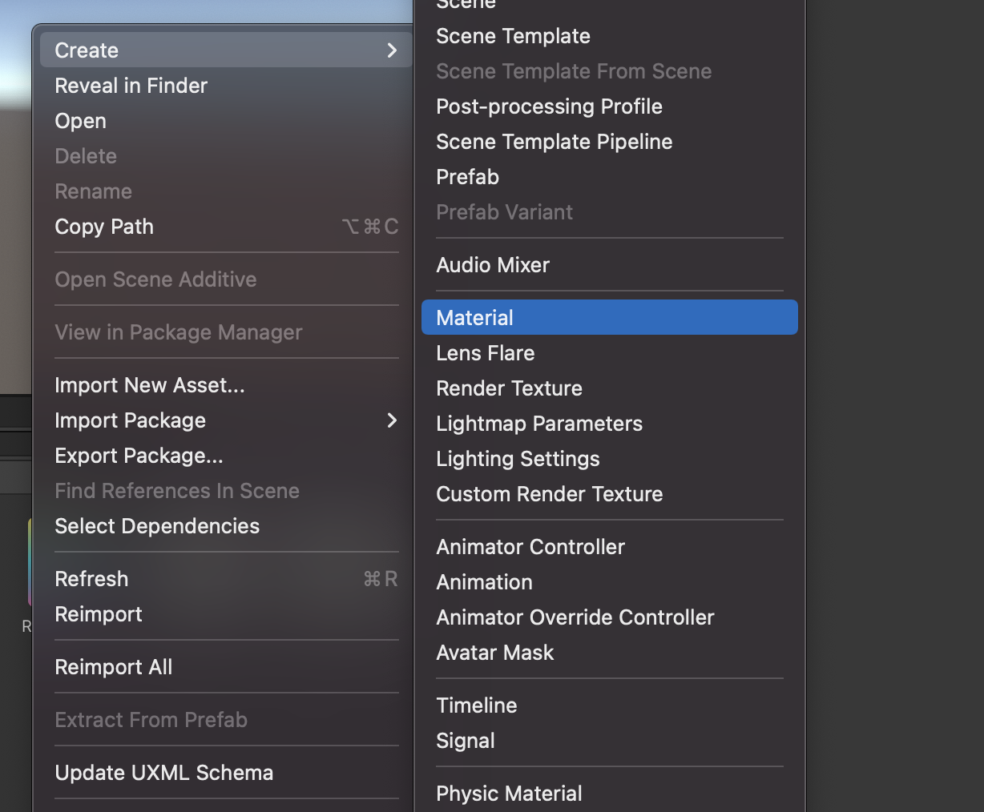
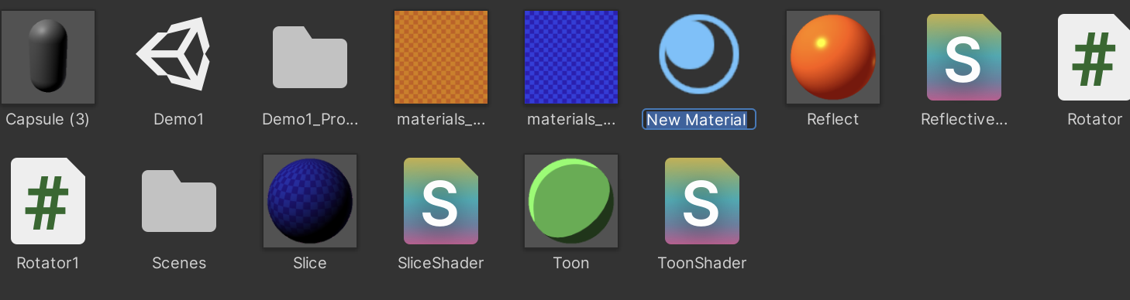
Demo
Create a new material
Assets>Create>Material
Rename Material “ToonShader” in Assets Folder

Slide 12
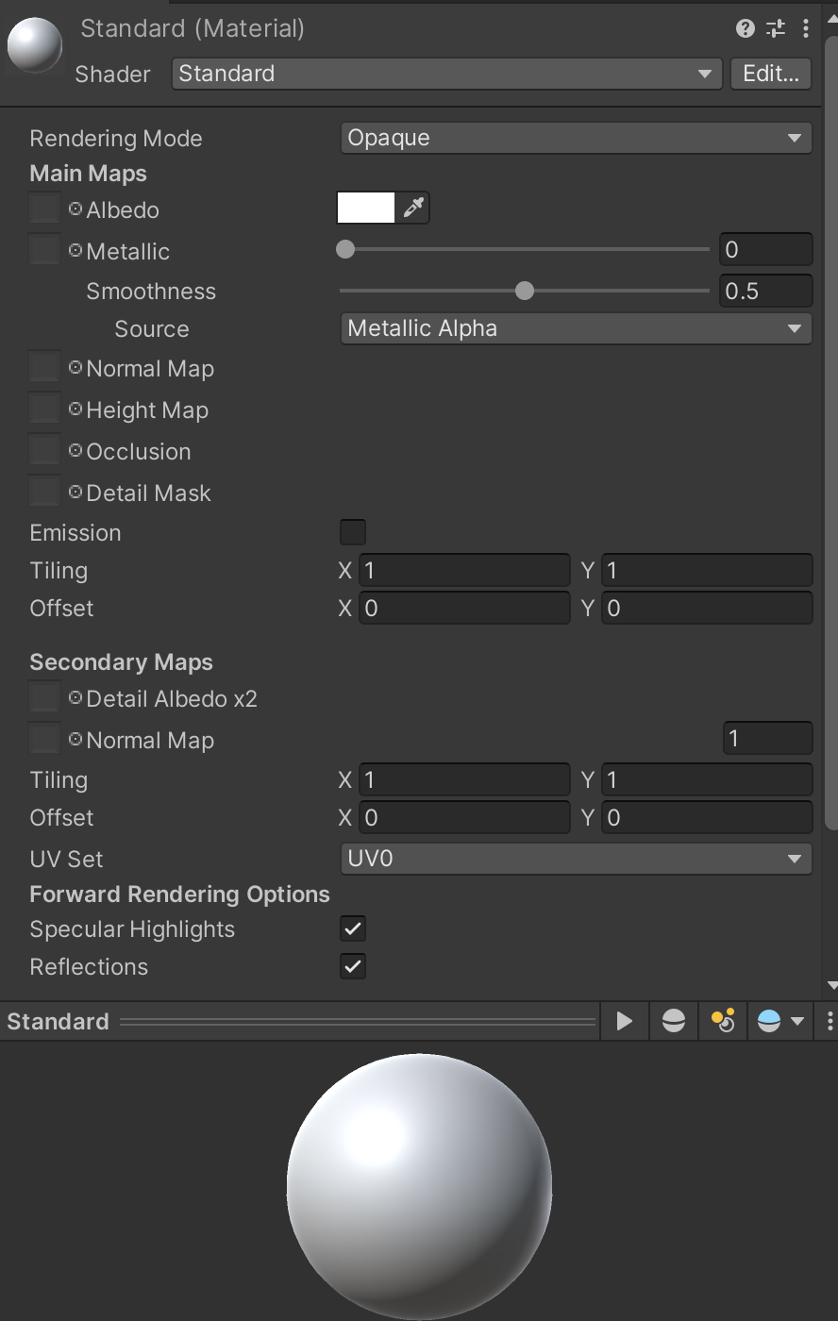
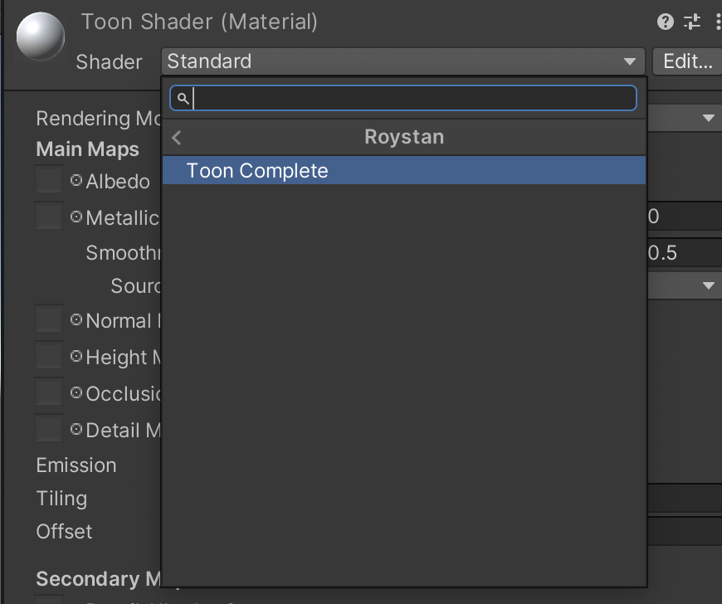
Demo
-Select ToonShader in Assets Folder
-In the inspector select the Shader dropdown. It should currently be set to Standard
-Select Roystan>ToonComplete in dropdown

Slide 13
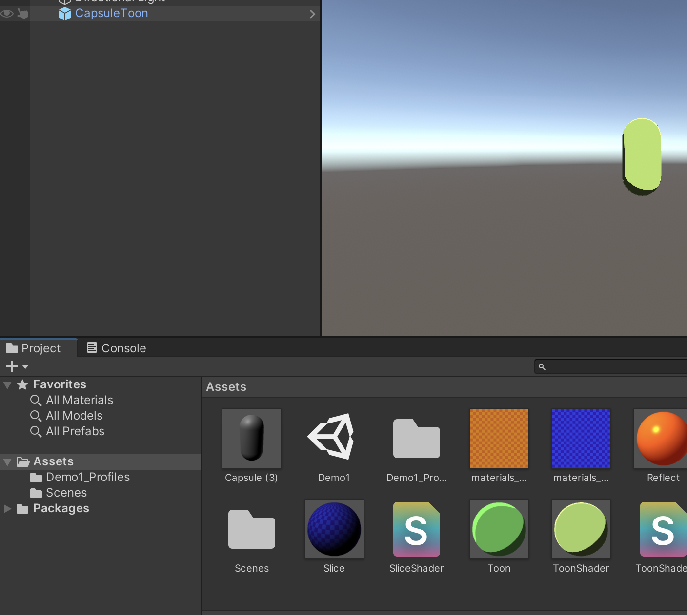
Demo
In the Inspector of the material, change color. Play with the sliders!
Drag ToonShader to the desired object’s name in the hierarchy or select the object OR select the desired object and drag ToonShader to the inspector to the to apply the shader!

Slide 14
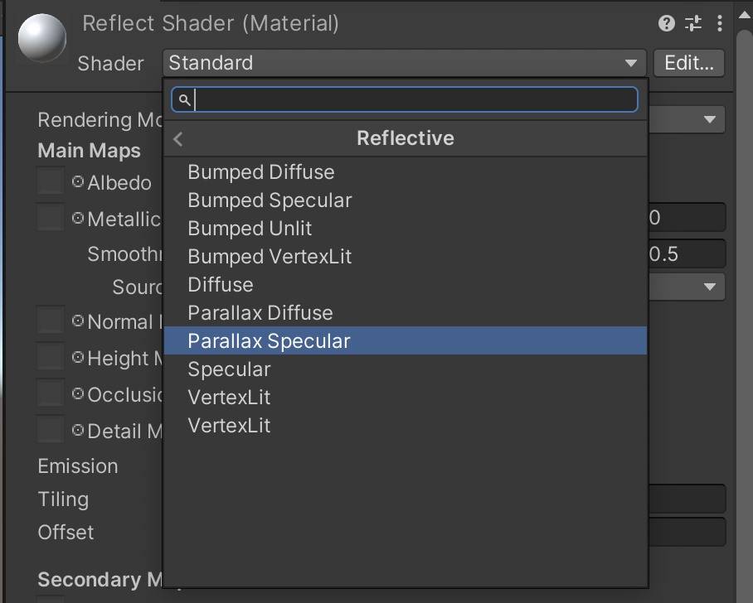
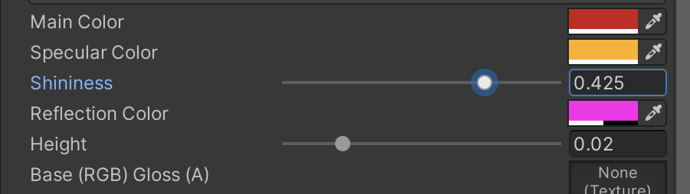
Demo
-Create another new material by clicking Assets>Create>Materials
-Name the Material ReflectShader and open it in the Inspector
-In the Shader Dropdown, select LegacyShaders>Reflective>Parallax Specular
-Play with the settings of the shader to see how it affects an object
-Apply shader to an object by dragging it to its inspector or hierarchy

Slide 15
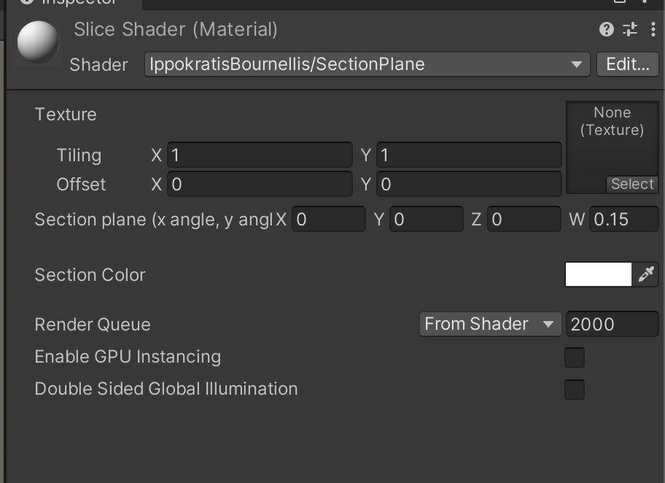
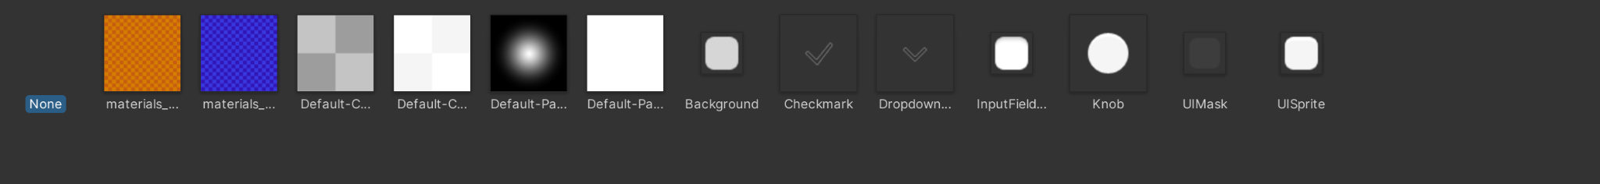
Demo
-Create a new material named Slice Shader
-select a new texture by either dragging a texture from the assets folder to the texture box, or clicking “select” inside the texture box
-

Slide 16
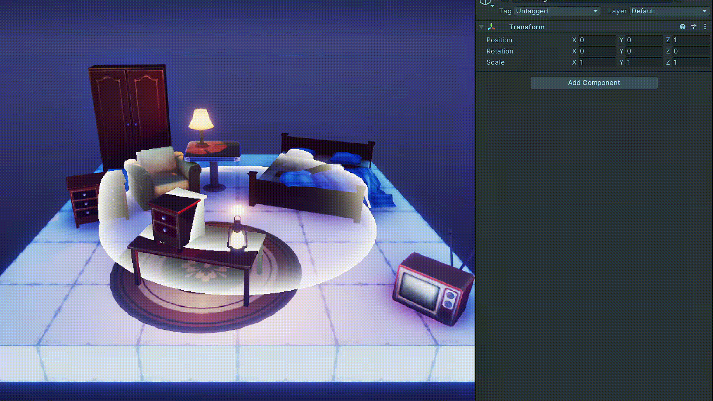
Post Processing Effects
-Visual effects applied at the end of rendering a scene
-Utilize shaders to create effects
-Can adjust game appearance or add special effects
Sonar effect by Mirza Beig

Slide 17
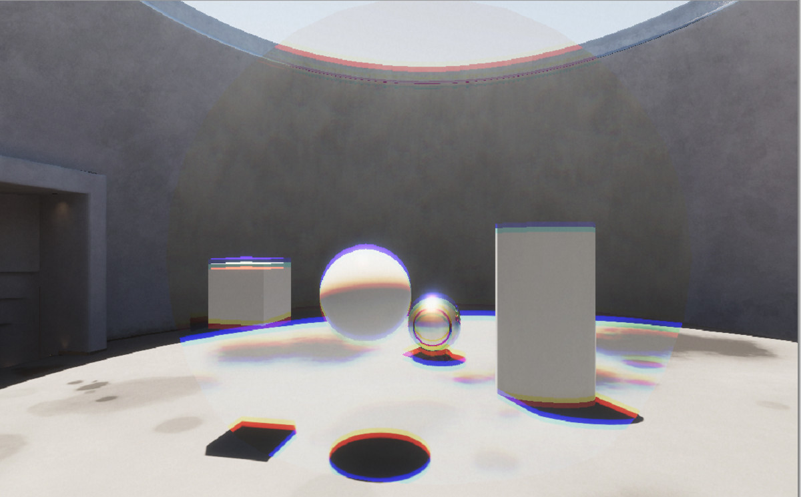
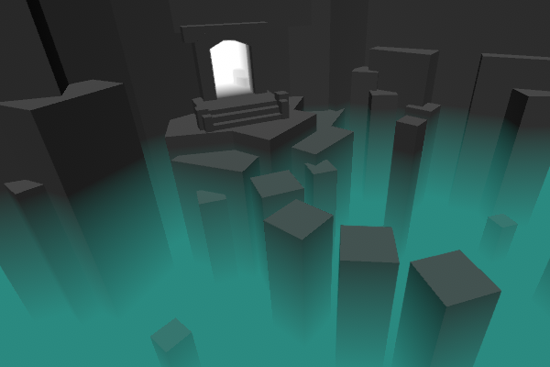
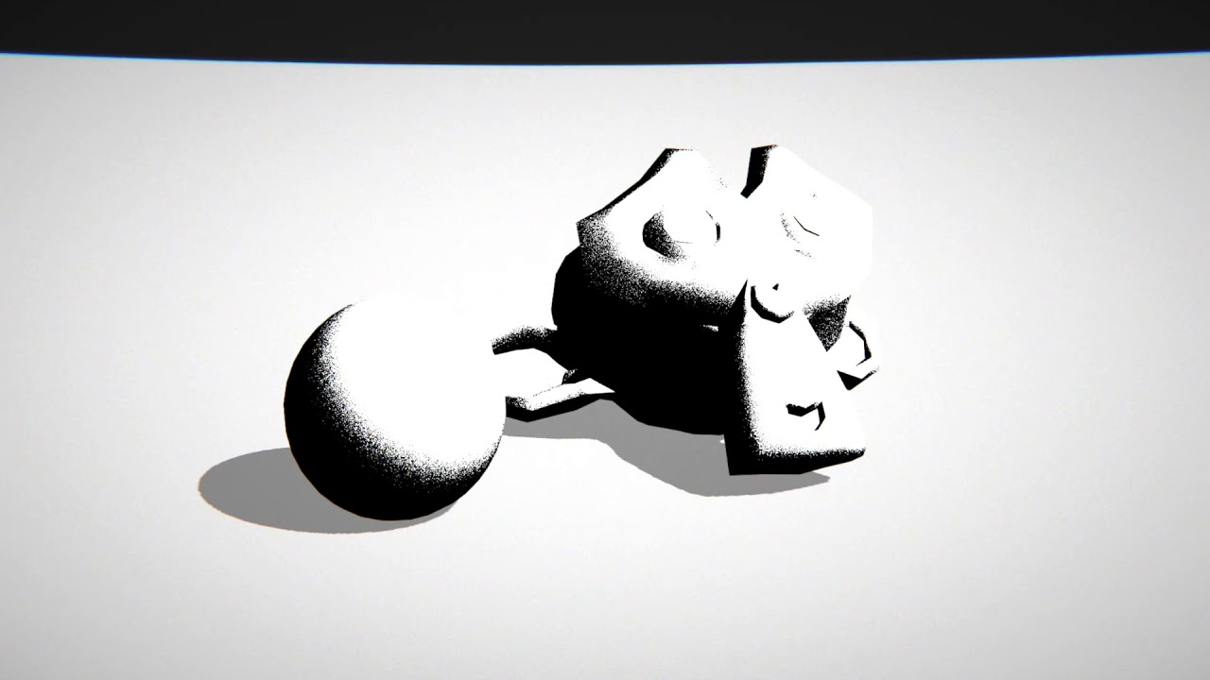
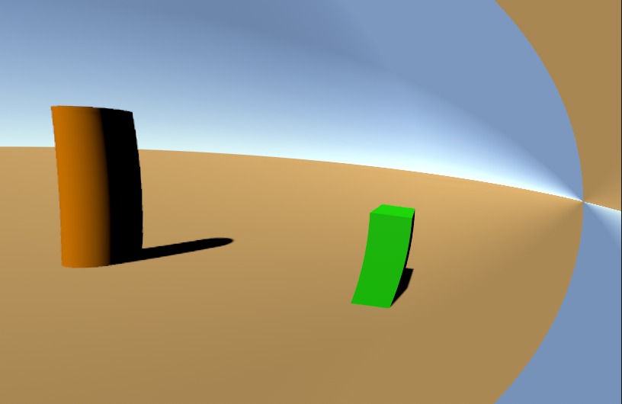
Notes:
-chromatic aberration
-fog
-grain
-lens distortion

Slide 18
Post Processing vs. Shaders
Post Processing Effects
Both
Shaders
Part of render and post processing steps in render pipeline
Available in Unity 2D
Applied to individual objects
Included in Unity Built-in Render Pipeline
Used in the post processing step in a Render pipeline
applied to entire scenes at once
Used in render pipeline
Available in unity 3D
Alters pixels color/lightness to produce an image
Included in Unity Universal Render Pipeline
Notes:
Built in
Universal Render
High def render

Slide 19
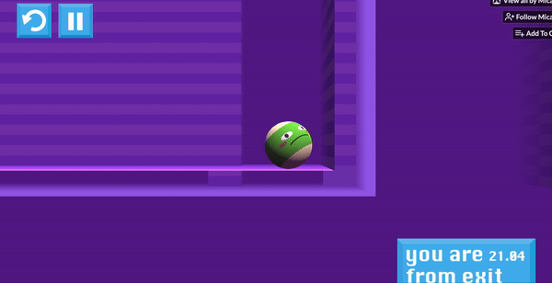
Example of Post Processing Effects in Action
Notes:
Post processing effect was used to add 2-direction fog that hid both the front and back parts of scene objects!
We tried to use shaders to get this effect but post-processing ended up being a better fit since the maze-shaped objects were all different for each level, and the post processing moved with the camera automatically, while a shader would have to program that

Slide 20
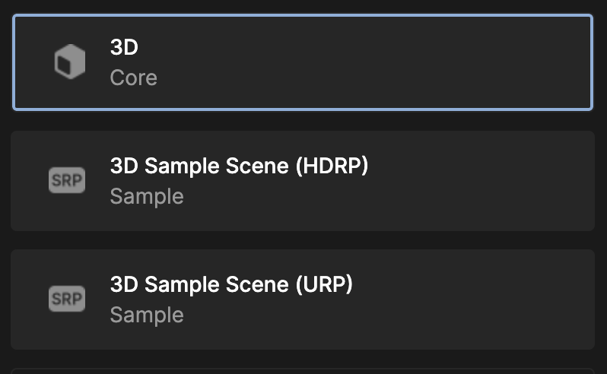
Post Processing Effects Demo in Unity
Some notes:
We are using the Built-in pipeline. There are 2 other options for post processing in unity. (URP, HDRP)
My version of Unity: 2021.1.10f1
Notes:
Adding unity based post processing effect to the same scene (fast)
Go over:
Installing post processing in package manager
Creating PPV and adding it to camera
“Using Chromatic aberration effect”

Slide 21
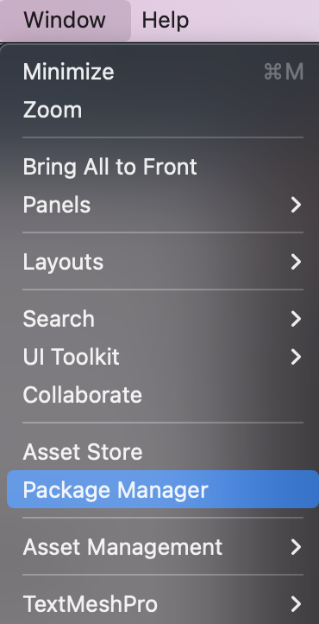
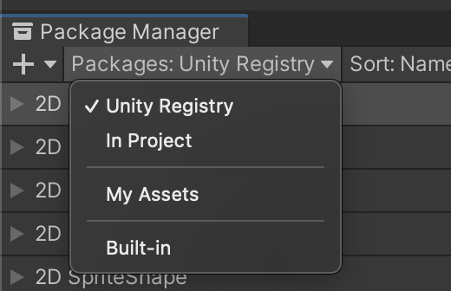
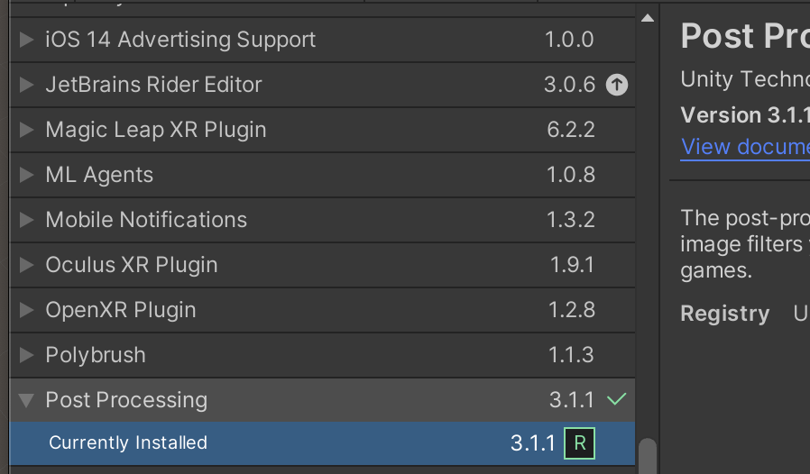
Setting Up
To allow for post processing using :
Go to window>Package Manager
In package manager window:
Select dropdown that says Packages: In Project and change settings to Unity Registry
In the list of packages:
Select Post Processing and click “install” to add post processing abilities to your scene

Slide 22
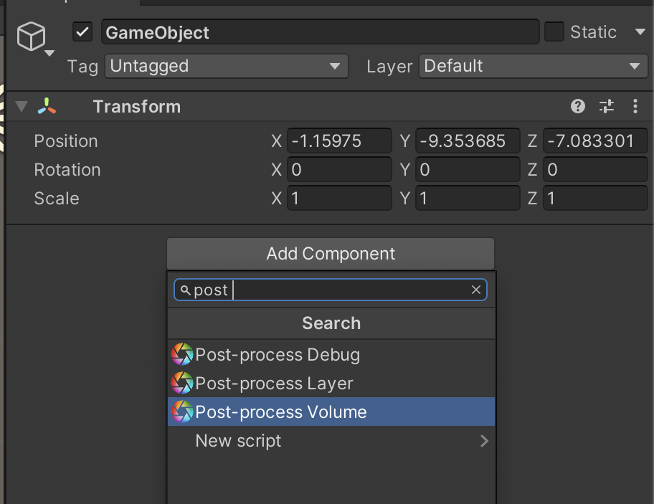
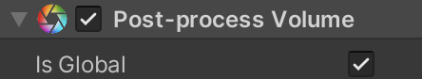
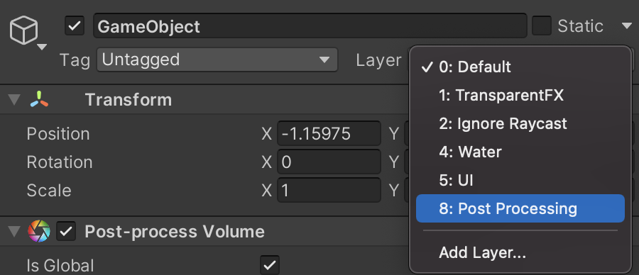
Creating a Post Processing Volume
Create an empty game object
In this game object click AddComponent> Post-process Volume
Toggle IsGlobal to “on”
Create a new layer called “Post Processing” and set that as the game object’s layer

Slide 23
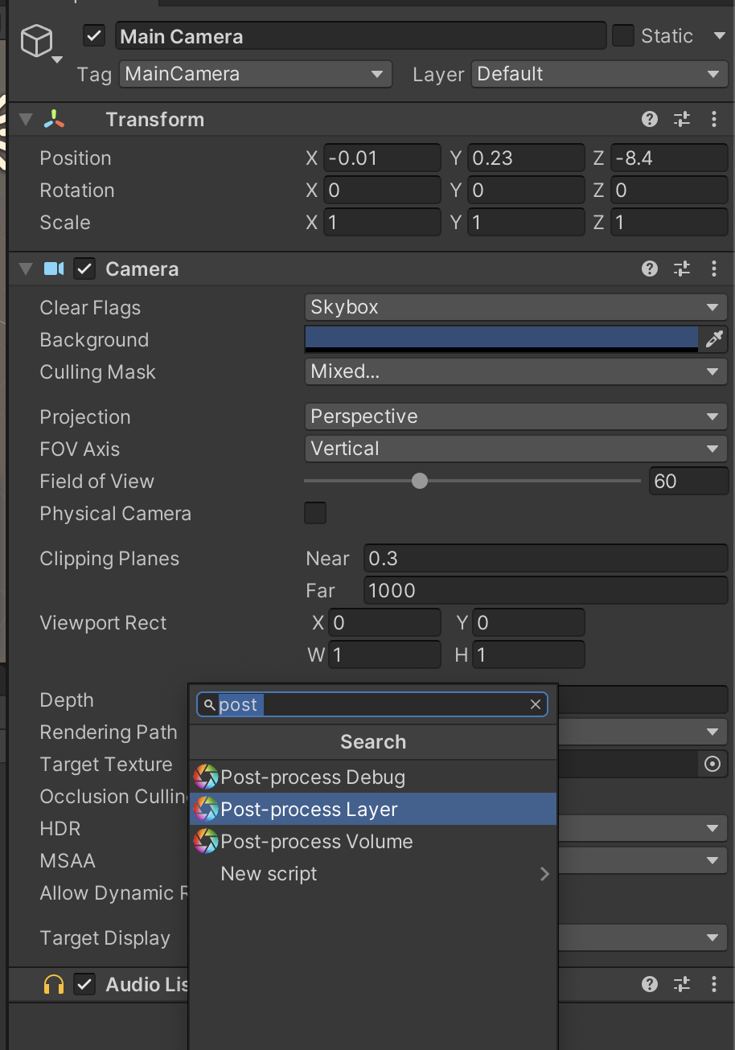
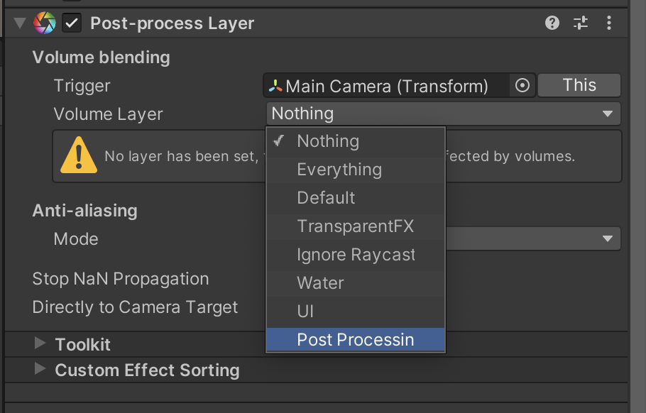
Managing the Layers
In Main Camera add a Post Processing Layer component
In the PP Layer, set the volume layer to “Post Processing” (the one we just made)
In the post process volume create a new profile

Slide 24
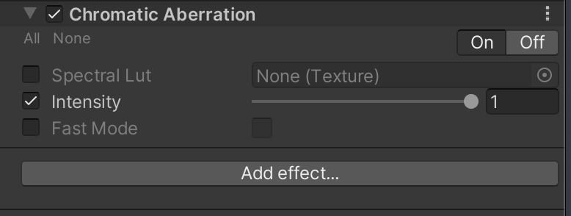
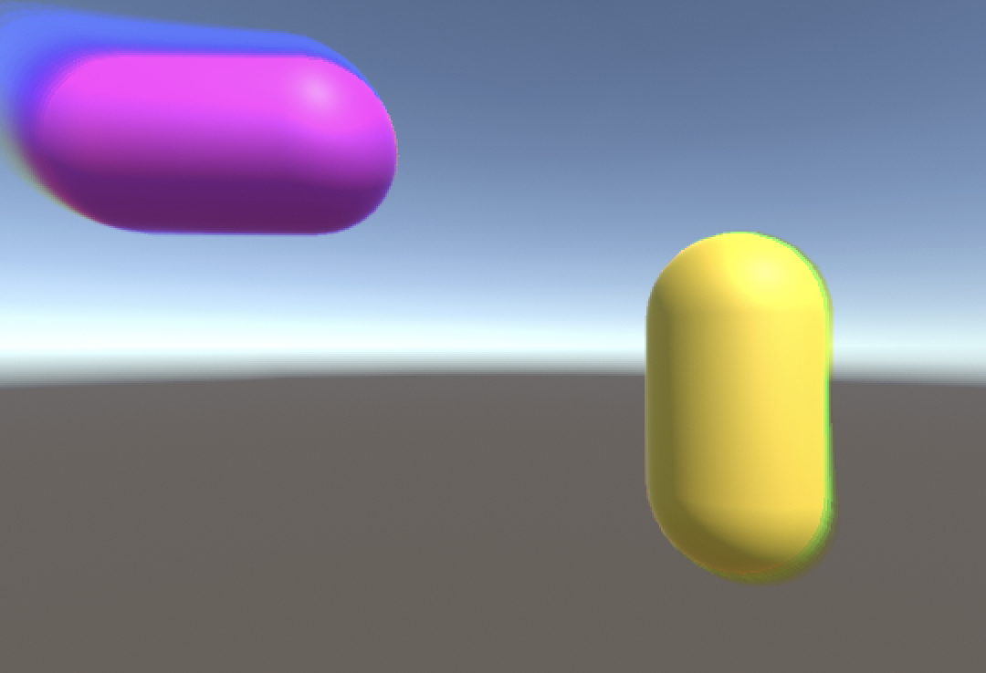
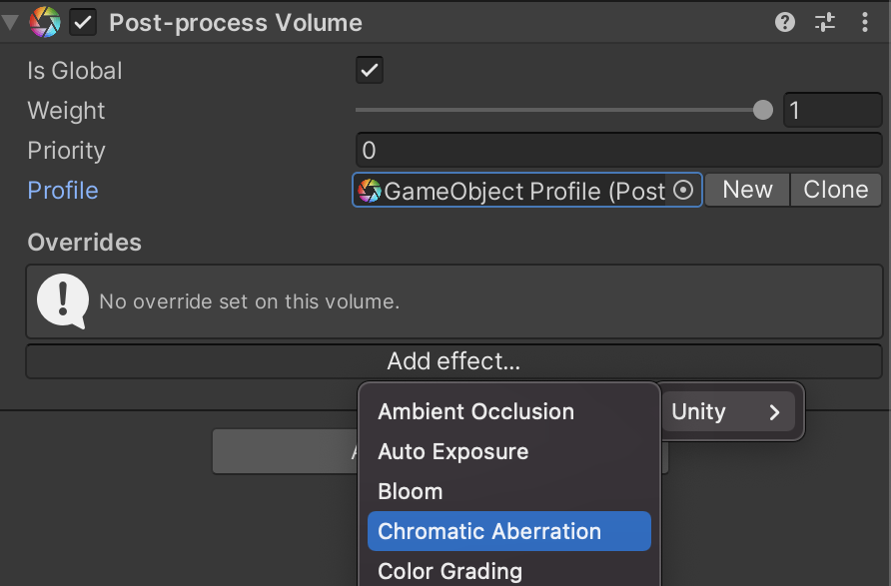
Getting the Effect
In your Post Processing Volume select “New Profile”
Select Add override>Chromatic Aberration
Set the intensity to 1

Slide 25
To Submit
If you choose to work on the Shader Demo, post to piazza>tutorials a screenshot of 1 object with one of the demo shaders applied to it

Slide 26
Thank you ♡

Slide 27
Cool Shader/Post Processing List to check out!
Colorize, Invert, Night Vision, Blur, Contour: https://github.com/MinaPecheux/ShaderJourney/tree/master/Assets/Shaders/Episode-03
Hologram: https://github.com/andydbc/HologramShader
Toon: https://github.com/IronWarrior/UnityToonShader
Pixel: https://bitbucket.org/gaello/pixelated-shader/src/master/
Water surface: https://github.com/PunkCG/Unity-Surface-Water-Shader
Dithering: https://github.com/samuelbigos/godot_dither_shader
Sketch and Outline Shaders: https://github.com/candycat1992/NPR_Lab/tree/master/Assets/Shaders
Motion blur: https://github.com/keijiro/KinoMotion

Slide 28
Sources/Interesting Links
https://www.raywenderlich.com/5671826-introduction-to-shaders-in-unity
https://thebookofshaders.com/01/
https://docs.unity3d.com/560/Documentation/Manual/shader-NormalFamily.html
https://docs.unity3d.com/Manual/PostProcessingOverview.html
https://docs.unity3d.com/Packages/com.unity.render-pipelines.high-definition@15.0/manual/Override-Fog.html?q=fog
https://www.youtube.com/watch?v=sXbdF4KjNOc
https://www.youtube.com/watch?v=dCvE0uJbP-I
https://docs.tizen.org/application/native/guides/graphics/vertex-shader/
https://webgl-shaders.com/
https://en.wikipedia.org/wiki/Shader
https://valdarixgames.medium.com/adding-post-processing-to-unity-6254a5c75427

